Slide 1
INFORMATION RETRIEVAL SYSTEMS PRACTICAL 5
Presented by : 18BCE101 Labdhi Sheth

Slide 2
Natural language processing 1. N-Grams The objective of this experiment is to learn to calculate bigrams from a given corpus and calculate probability of a sentence.

Slide 3
Overview of the experiment
Probability of a sentence can be calculated by the probability of sequence of words occurring in it.
We can use first order Markov model or the bigram model. Bigrams can be generalized to the n-gram which looks at (n-1) words in the past.
P(w(1), w(2)..., w(n-1), w(n))= P(w(2)|w(1)) P(w(3)|w(2)) …. P(w(n)|w(n-1))
∑words = a sentence.
Sentence is meaningful only when the words are arranged in some order. And thus to handle unacceptable sentences, we assign probabilities to the strings of words.
We use (eos) tag to mark the beginning and end of a sentence.

Slide 4
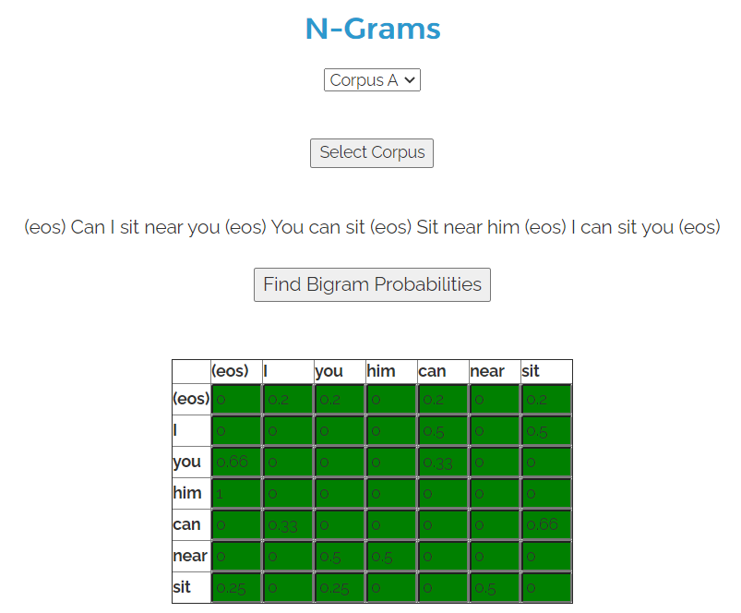
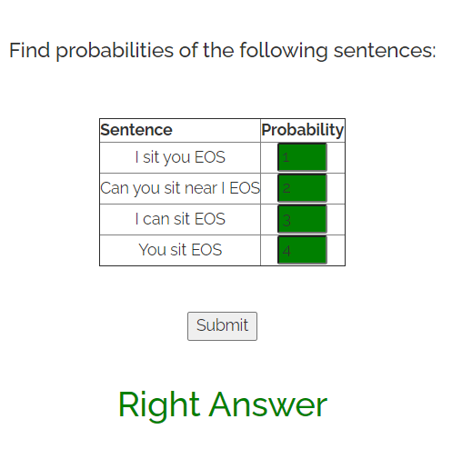
Practical experiment result:

Slide 5
Observation and Conclusion -
Observation:
N-gram is thought if as the sequence of N words, by that notion, a 2-gram (or bigram) is a two-word sequence of words like “please turn”, The n-gram idea calculates the likelihood of sentence. However, these models doesn’t get semantic meanings of the text.
Conclusion:
Generally trigrams are used for large corpora (millions of words) while bigrams are used for smaller texts. The selection of n in n-gram is sometimes referred to as bias-variance tradeoff, in simpler terms, the balance between appropriateness/effectiveness and stability of the estimates. The n-gram model generally gives good results for sufficient n and given appropriate corpora.

Slide 6
Natural language processing 2. Chunking The objective of this experiment is to understand the concept of chunking and get familiar with the basic chunk tagset.

Slide 7

Overview of the experiment
Chunking of text involves dividing a text into syntactically correlated words.
Chunk patterns are the patterns of part-of-speech (POS) tags that define what kind of words made up a chunk. We can define chunk patterns with the help of modified regular expressions.
Chunks have open boundary and closed boundary. This is expressed with IOB prefixes. B-chunk is for first word and I-chunk is for other word in chunk.
Chunking all proper nouns (tagged with NNP) is a very simple way to perform named entity extraction.

Slide 8
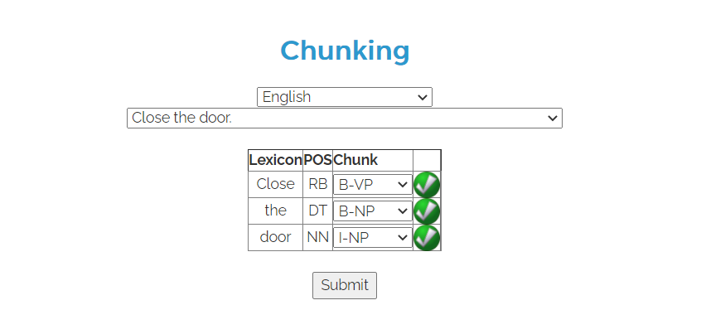
Practical experiment result:
Common chunks are:
Noun chunks
Verb chunks
Adjectival chunks
Adverb Chunks
Prepositional chunks

Slide 9
Observation and Conclusion -
Observation –
Chunking is a process of extracting phrases from unstructured text, which means analyzing a sentence to identify the constituents(Noun Groups, Verbs, verb groups, etc.) However, it does not specify their internal structure, nor their role in the main sentence.
Conclusion –
Chunking can break sentences into phrases that are more useful than individual words and yield meaningful results. Chunking is very important when you want to extract information from text such as locations, person names. (entity extraction)

Slide 10
Thank you

